Slide 1


BIG DATA ANALYSIS FINAL PROJECT
THE 3C
FORMULA OF FFSO IN THE GREATER CHINA
DATA BASE: DOUBAN.COM

Slide 2

Video For Brief Introduction
fame
fortune
why so popular?
how could it happened?
stars
content
Is traffic king?
how to choose?

Slide 3


Slide 4

CONTENTS
Catastrophe
Content
Cast
Channel
Conclusion

Slide 5

Catastrophe
CN vs HK vs TW Market

Slide 6
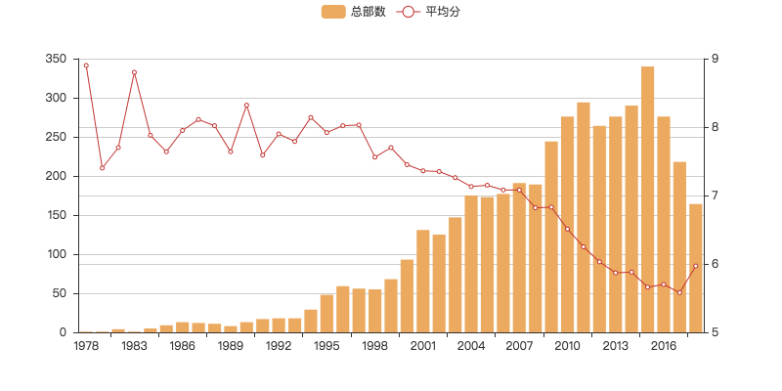
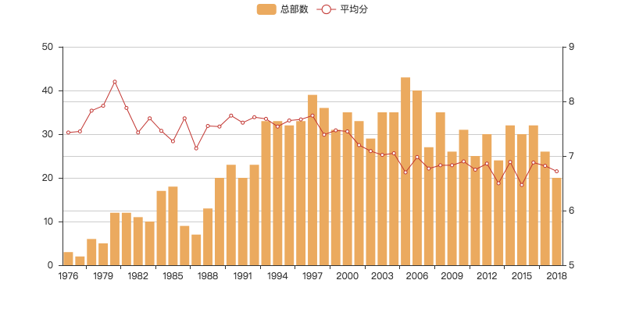
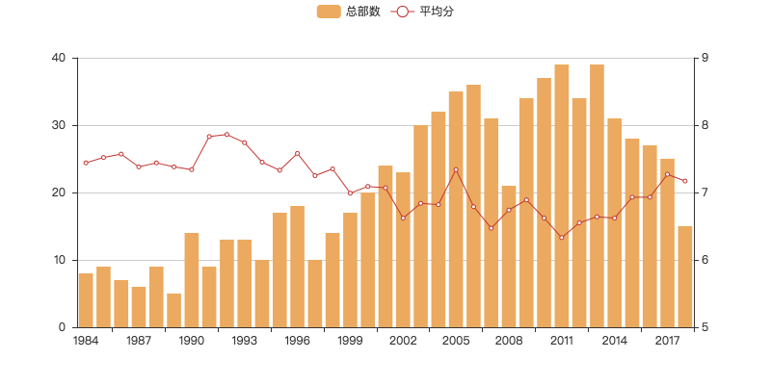
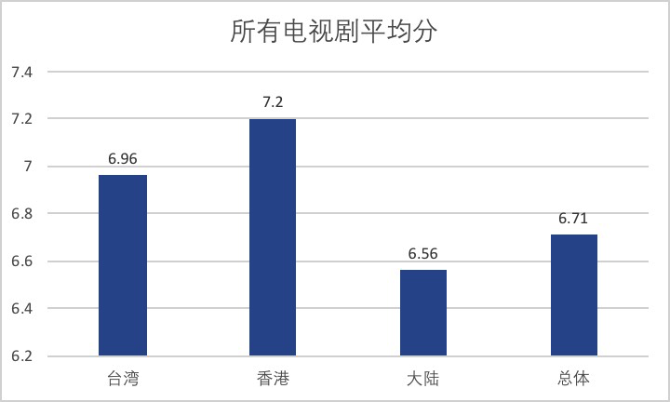
CN vs HK vs TW Markets
Mainland:
More Dramas
Lower Rating

Slide 7

Content
Top & Most Rated
Major Categories

Slide 8
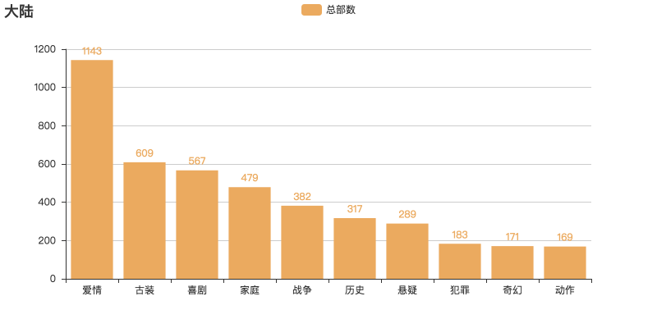
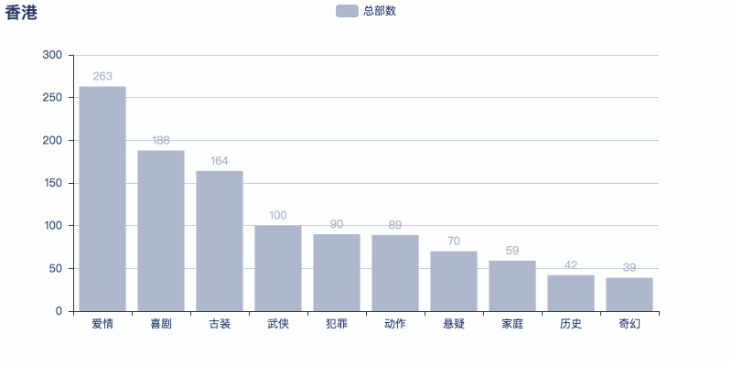
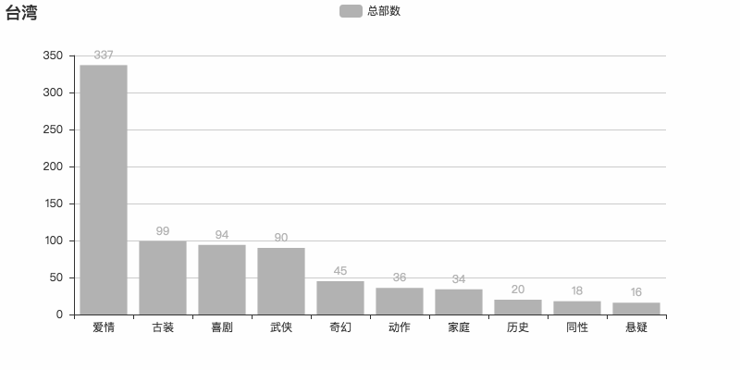
Major Categories
CN HK TW
#Romance, Comedy, Costume stories dominate the markets.
#Homosexual is available only in TW, restricted in CN.

Slide 9

Top Trending Categories
⅓ of total
⅔ of the top rated
Notes:
some themes are limited due to the Approval System, but andiance like them a lot.
it’s better to add some #Love elements.【已经补充新图】

Slide 10
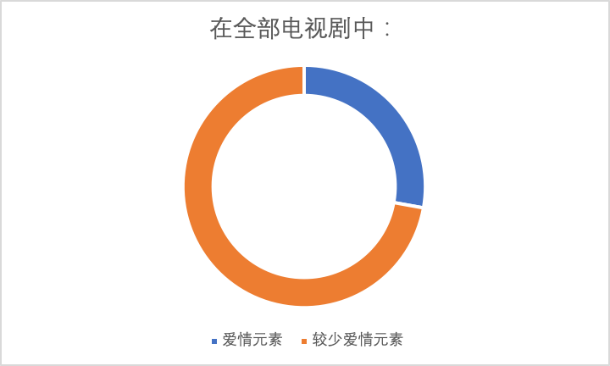
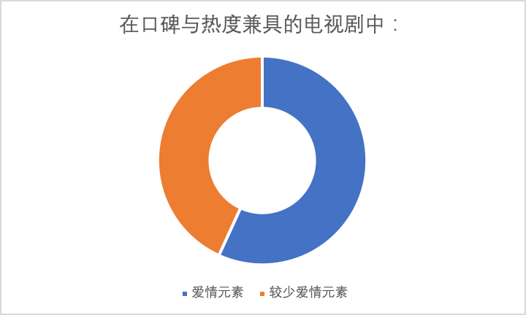
“20/80 Effect” of Romance Movies
It’s better to add some #Romance elements.

Slide 11


Major Categories
Story of the Yanxi Palace Guardian

Slide 12

Cast
Most Seen Cast in Catastrophe
Experience
The Relationships Between Actors

Slide 13





Most Seen Cast in Catastrophe
Yes Mr Fashion
4.7/10( by 50631)
Fighter of the Destiny
4.2/10(by 67631)
Negotiator
3.4/10(by 54772)
Pretty Li Huizhen
2.8/10(by 109350)
Notes:
commons:
Adapted from successful South Korean / Japan TV soaps or popular online novels；
Casts are famous actors with huge influence(such as huge numbers of Weibo followers);

Slide 14




Slide 15
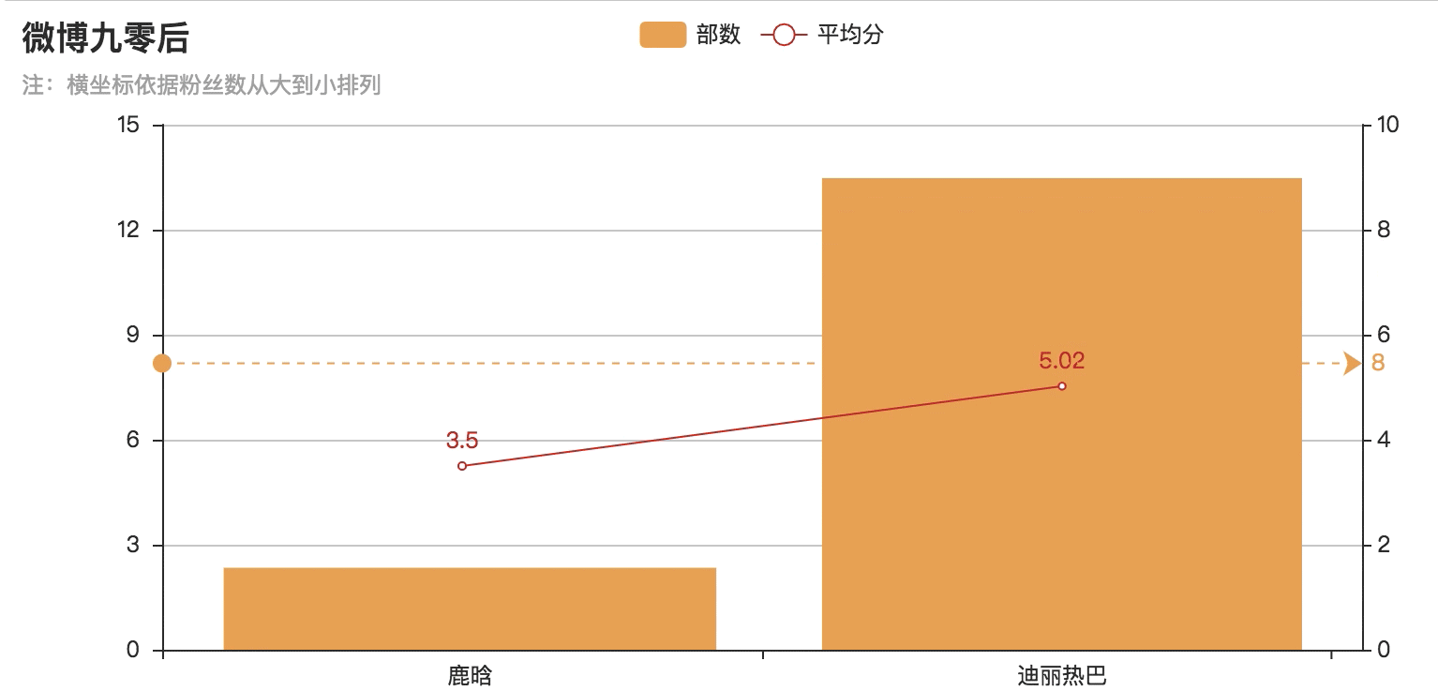
Most Seen Cast in Catastrophe

Slide 16

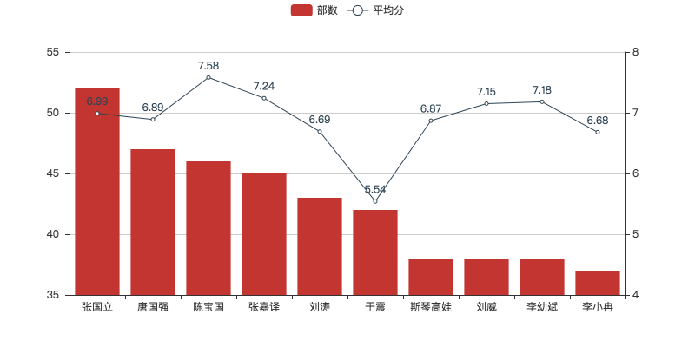
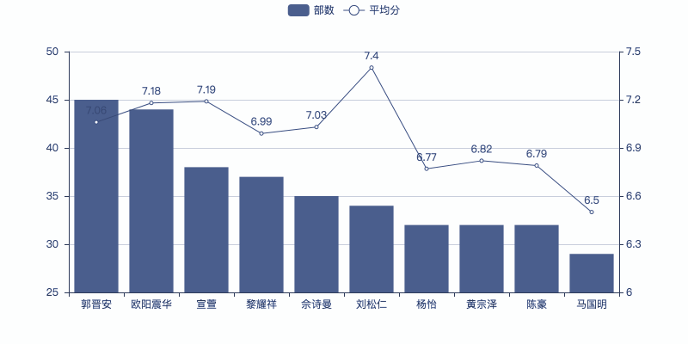
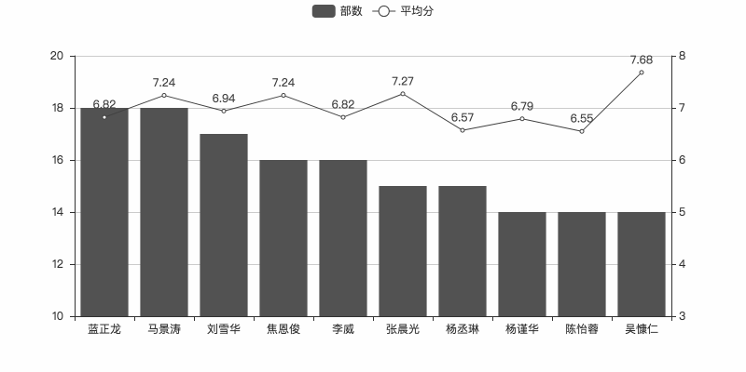
Experiences of the Cast
CN HK TW
Experiences guarantee the outcome.
Notes:
there are

Slide 17
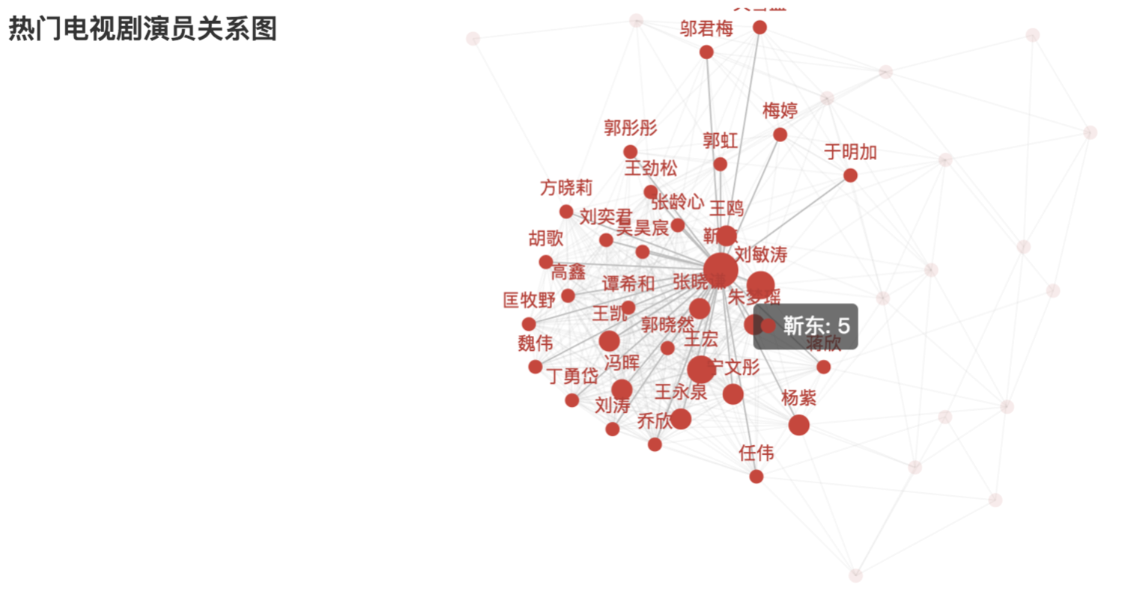
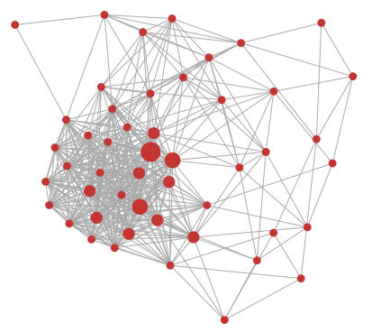


The Relationships Between Actors
NIRVANA IN FIRE THE DISGUISER

Slide 18
Channel
Censorship of the Dramas
Go Online

Slide 19
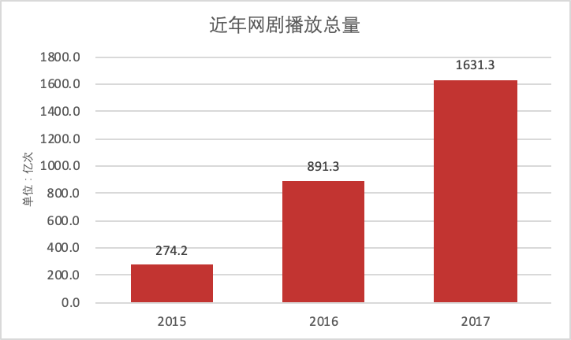
Number of the Online Dramas Played
Online streaming is gaining popularity.
resource:chyxx.com(中国产业信息网)
Notes:
there are

Slide 20
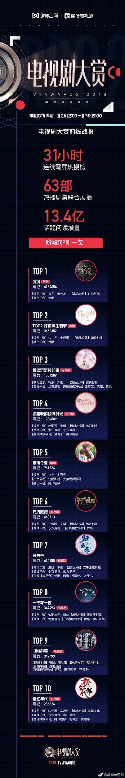
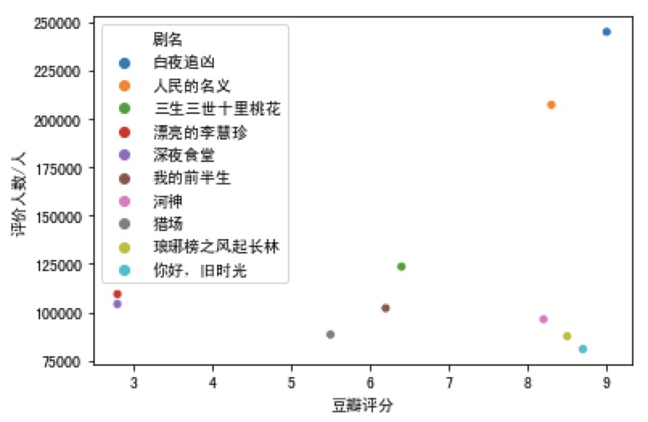
Go Online
2 in top 3, 2018
1 in top 3, 2017

Slide 21

Conclusion
What Make Hit Dramas Hit
Content
Fusion & Adaptation
Experience & Relation
Cast
Go for Online
Channel

Slide 22
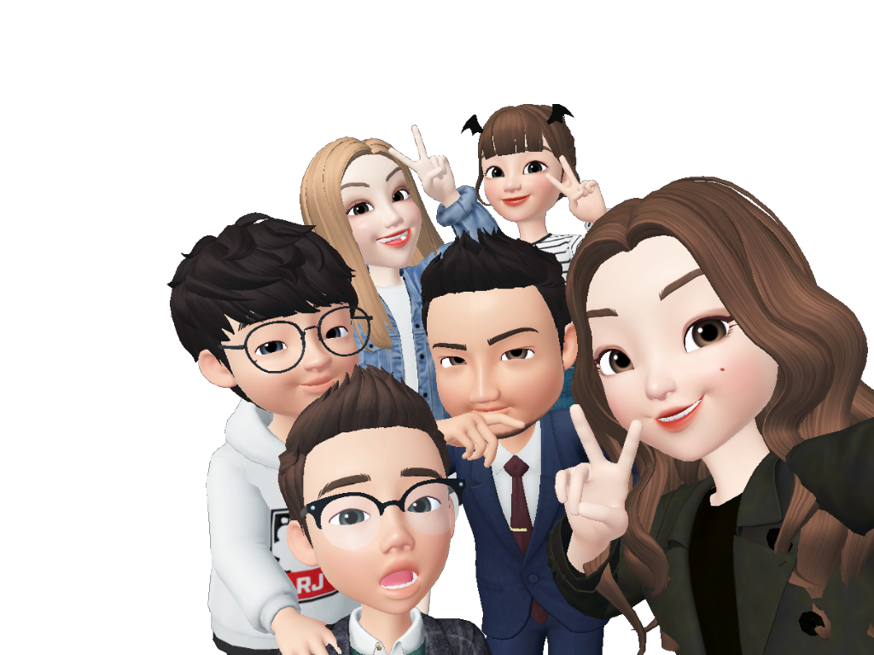
THANK
YOU
GROUP MEMBERS:
ZENG SINING
LIN HUIQING
LUO YI
HUANG YANGMING

